Slide 1
Week7-Lec1
IP layer Fundamentals

Slide 2
Network layer: our goals
Principles:
network layer service models
forwarding versus routing
how a router works
addressing
generalized forwarding
IP protocol
NAT

Slide 3
Network layer: “data plane” roadmap
Network layer: overview
data plane
control plane
What’s inside a router
input ports, switching, output ports
buffer management, scheduling
IP: the Internet Protocol
datagram format
addressing
network address translation

Slide 4








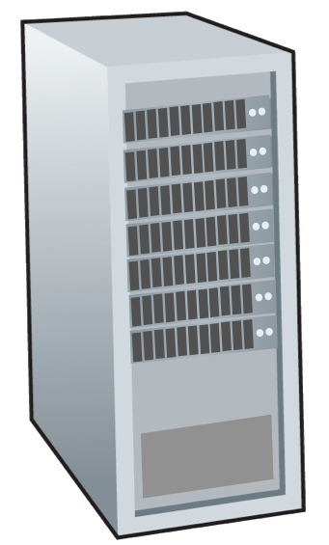







Network-layer services and protocols
transport segment from sending to receiving host
sender: encapsulates segments into datagrams, passes to link layer
receiver: delivers segments to transport layer protocol
network layer protocols in every Internet device: hosts, routers
routers:
examines header fields in all IP datagrams passing through it
moves datagrams from input ports to output ports to transfer datagrams along end-end path
mobile network
national or global ISP
application
transport
network
link
physical
network
link
physical
network
link
physical
network
link
physical
network
link
physical
network
link
physical
datacenter
network
application
transport
network
link
physical
enterprise
network

Slide 5
Network service model
Q: What service model for “channel” transporting datagrams from sender to receiver?
example services for individual datagrams:
guaranteed delivery
guaranteed delivery with less than 40 msec delay
example services for a flow of datagrams:
in-order datagram delivery
guaranteed minimum bandwidth to flow
restrictions on changes in inter-packet spacing

Slide 6
Network-layer service model
Quality of Service (QoS) Guarantees ?
Network
Architecture
Internet
ATM
ATM
Internet
Internet
Service
Model
best effort
Constant Bit Rate
Available Bit Rate
Intserv Guaranteed
(RFC 1633)
Diffserv (RFC 2475)
Bandwidth
none
Constant rate
Guaranteed min
yes
possible
Loss
no
yes
no
yes
possibly
Order
no
yes
yes
yes
possibly
Timing
no
yes
no
yes
no
Internet “best effort” service model
No guarantees on:
successful datagram delivery to destination
timing or order of delivery
bandwidth available to end-end flow

Slide 7
Network-layer service model
Quality of Service (QoS) Guarantees ?
Network
Architecture
Internet
ATM
ATM
Service
Model
best effort
Constant Bit Rate
Available Bit Rate
Bandwidth
none
Constant rate
Guaranteed min
Loss
no
yes
no
Order
no
yes
yes
Timing
no
yes
no

Slide 8
Network layer: data plane, control plane
Data plane:
local, per-router function
determines how datagram arriving on router input port is forwarded to router output port
Control plane
network-wide logic
determines how datagram is routed among routers along end-end path from source host to destination host
values in arriving
packet header
two control-plane approaches:
traditional routing algorithms: implemented in routers
software-defined networking (SDN): implemented in (remote) servers
0111
1
3
2

Slide 9

Router interfaces
223.1.1.1
Q: how are interfaces actually connected?
223.1.2.1
223.1.1.2
A: wired
Ethernet interfaces connected by Ethernet switches
223.1.1.4
223.1.2.9
223.1.1.3
223.1.3.27
223.1.2.2
223.1.3.1
223.1.3.2
For now: don’t need to worry about how one interface is connected to another (with no intervening router)
A: wireless WiFi interfaces connected by WiFi base station

Slide 10

Per-router control plane
Individual routing algorithm components in each and every router interact in the control plane
Routing
Algorithm
control
plane
data
plane
values in arriving
packet header
0111
1
3
2

Slide 11
Two key network-layer functions
network-layer functions:
forwarding: move packets from a router’s input link to appropriate router output link
routing: determine route taken by packets from source to destination
routing algorithms

Slide 12
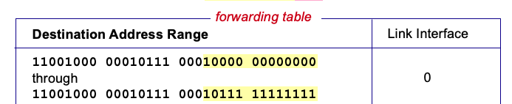
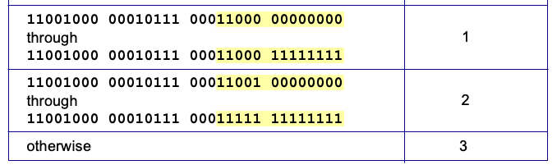
Destination-based forwarding
Notes:
Text for this animation:
This all works out pretty nice and looks pretty simple!
But of course the devil is in the details, as the saying goes.
What happens, for example, when a subset of addresses say in this first range should go to say interface 3, rather than interface 0. Well, of course we could split the first address range into multiple pieces, and add in this new subrange with its new destination output port. But it turns out there’s a much simpler and elegant way to do this. Known as longest prefix matching.

Slide 13
Longest prefix matching
longest prefix match
when looking for forwarding table entry for given destination address, use longest address prefix that matches destination address.
Destination Address Range
11001000 00010111 00010
11001000 00010111 00011000
11001000 00010111 00011
otherwise
Link interface
0
1
2
3
***
********
********
***
********
examples:
11001000 00010111 00010110 10100001
which interface?
11001000 00010111 00011000 10101010
which interface?

Slide 14
Longest prefix matching
Destination Address Range
11001000 00010111 00010
11001000 00010111 00011000
11001000 00010111 00011
otherwise
Link interface
0
1
2
3
***
********
********
match!
***
********
examples:
11001000 00010111 00010110 10100001
which interface?
11001000 00010111 00011000 10101010
which interface?

Slide 15
Longest prefix matching
Destination Address Range
11001000 00010111 00010
11001000 00010111 00011000
11001000 00010111 00011
otherwise
Link interface
0
1
2
3
***
********
********
***
********
match!
examples:
11001000 00010111 00010110 10100001
which interface?
11001000 00010111 00011000 10101010
which interface?

Slide 16
Longest prefix matching
Destination Address Range
11001000 00010111 00010
11001000 00010111 00011000
11001000 00010111 00011
otherwise
Link interface
0
1
2
3
***
********
********
***
********
match!
examples:
11001000 00010111 00010110 10100001
which interface?
11001000 00010111 00011000 10101010
which interface?

Slide 17
Longest prefix matching
longest prefix matching: often performed using ternary content addressable memories (TCAMs)
content addressable: present address to TCAM: retrieve address in one clock cycle, regardless of table size
Cisco Catalyst: ~1M routing table entries in TCAM

